Slide 1
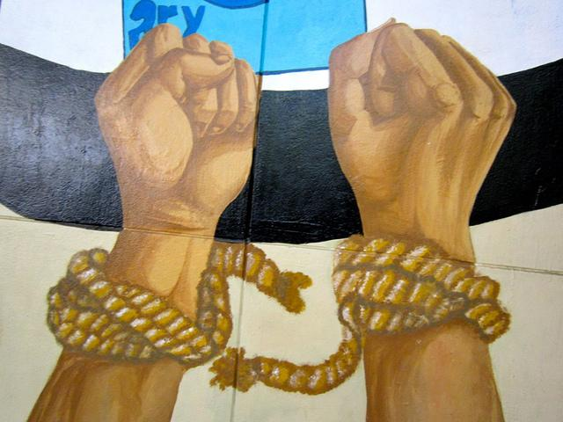
Abolition
Definition: (noun) the legal ending of slavery
Many people worked for the abolition of slaves.

Slide 2
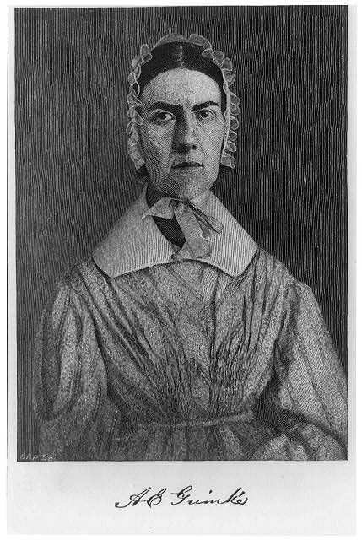
Abolitionist
Definition: (noun) a person who supported the ending of slavery in the United States
Angelina Grimke and Sojourner Truth were abolitionists who fought to end slavery.

Slide 3
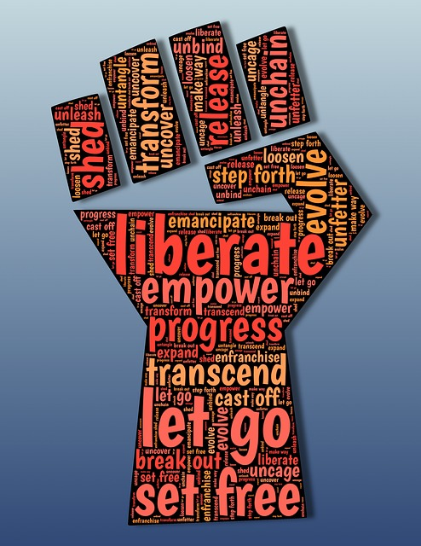
Emancipate
Definition: (verb) to free a slave
The 13th Amendment emancipated slaves.

Slide 4
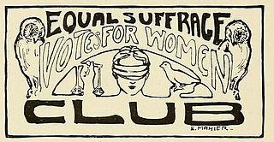
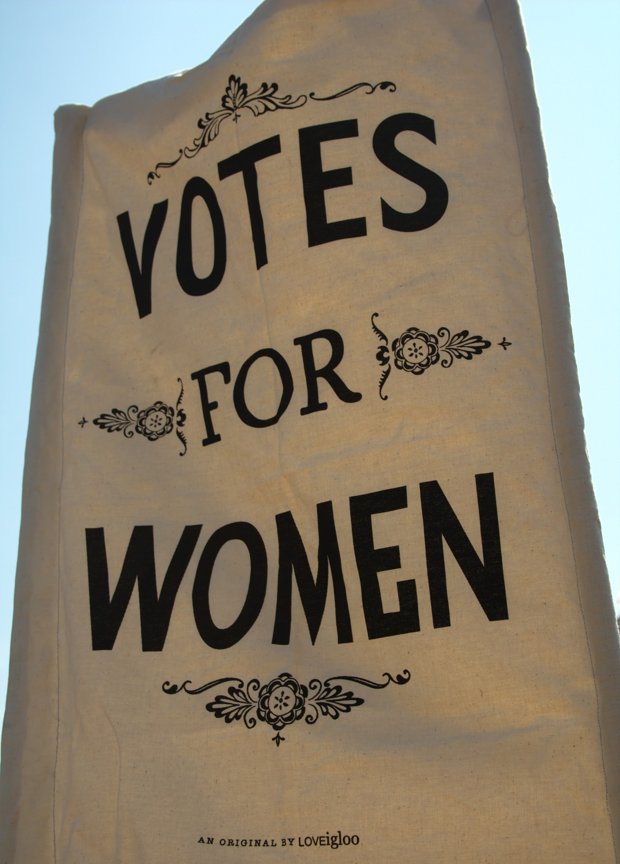
Suffrage
Definition: the right to vote in a political election
During the women’s suffrage movement, women fought for and won the right to vote in political elections.

Slide 5
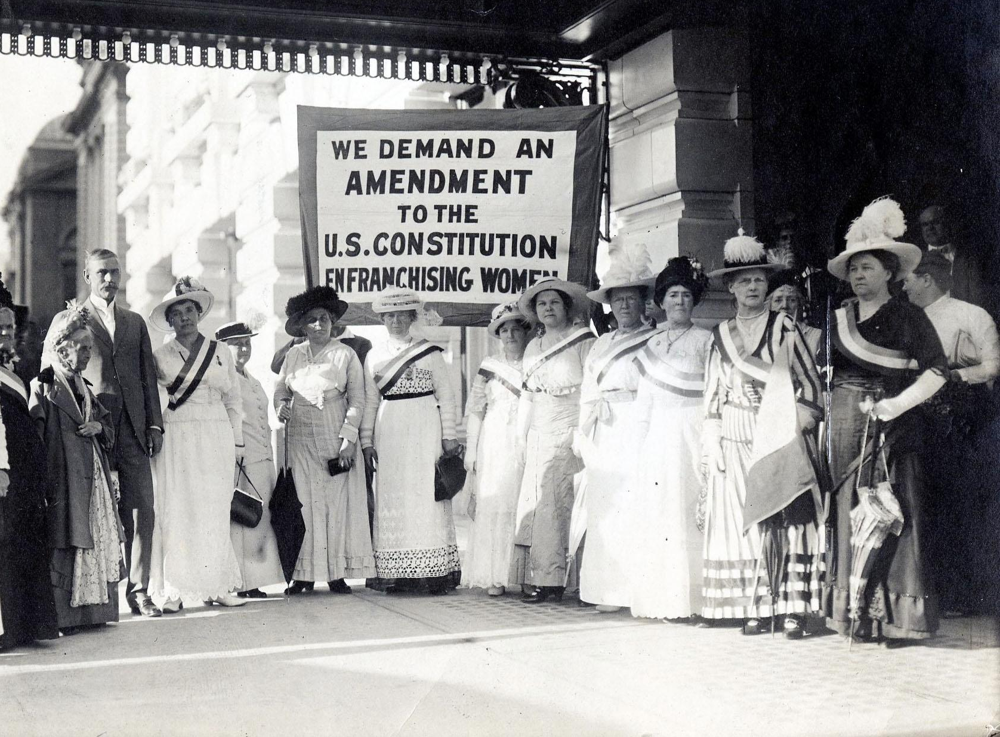
Suffragist
Definition: (noun) a person who worked to get voting rights for women
Many Utah women were suffragists who actively fought for suffrage.
National and Utah suffragists with Senator Smoot in August 1915. Photo courtesy of National Woman’s Party.

