Slide 1
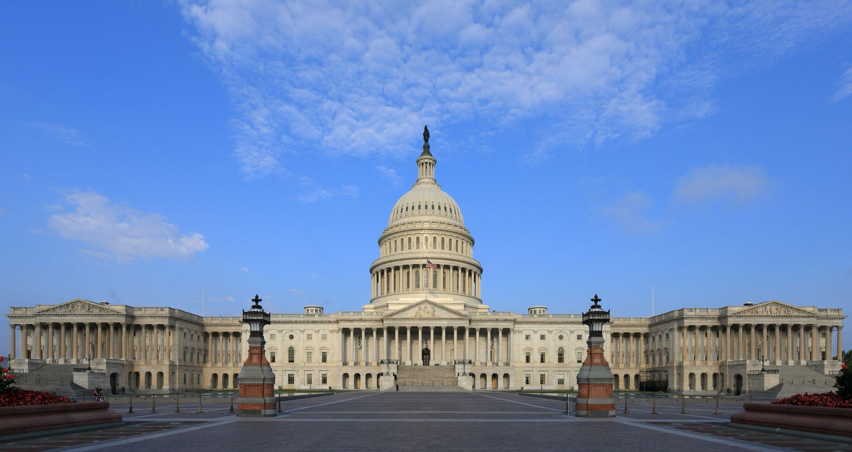
Courtesy of Martin Falbisoner, via Wikimedia Commons
U.S. Capitol Building
Washington, D.C.

Slide 2
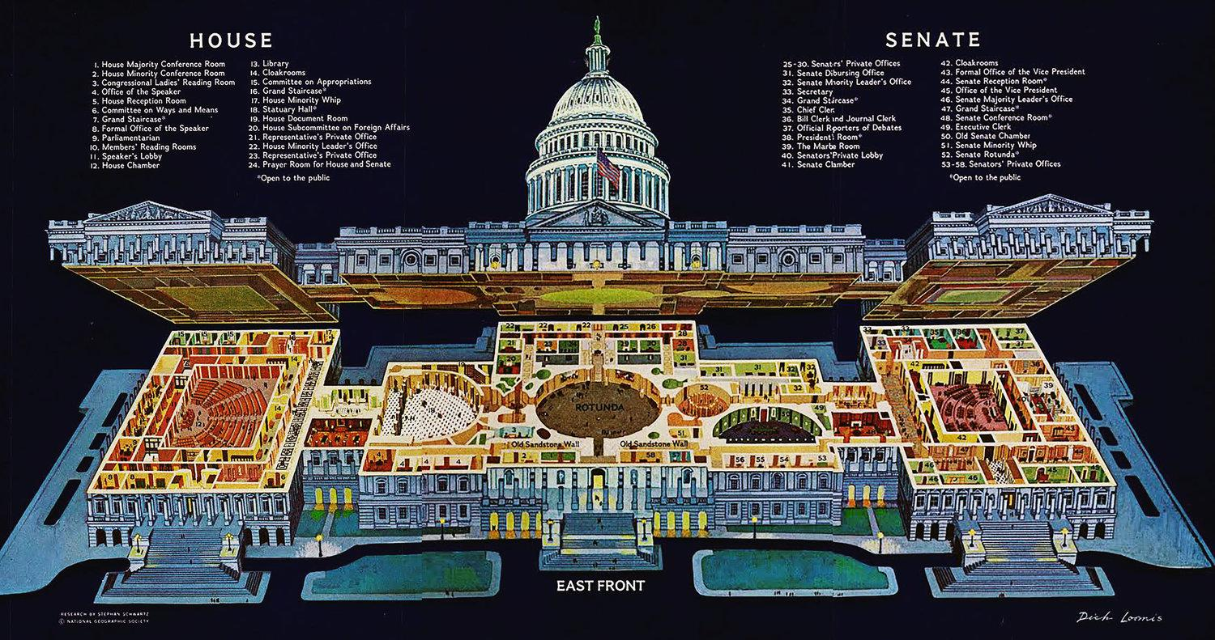
Old House Hall
National Statuary Hall

Slide 3
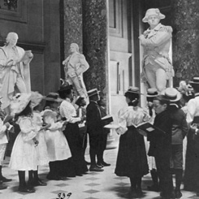
Courtesy of Library of Congress
National Statuary Hall, cir. 1898
school children visit the hall

Slide 4
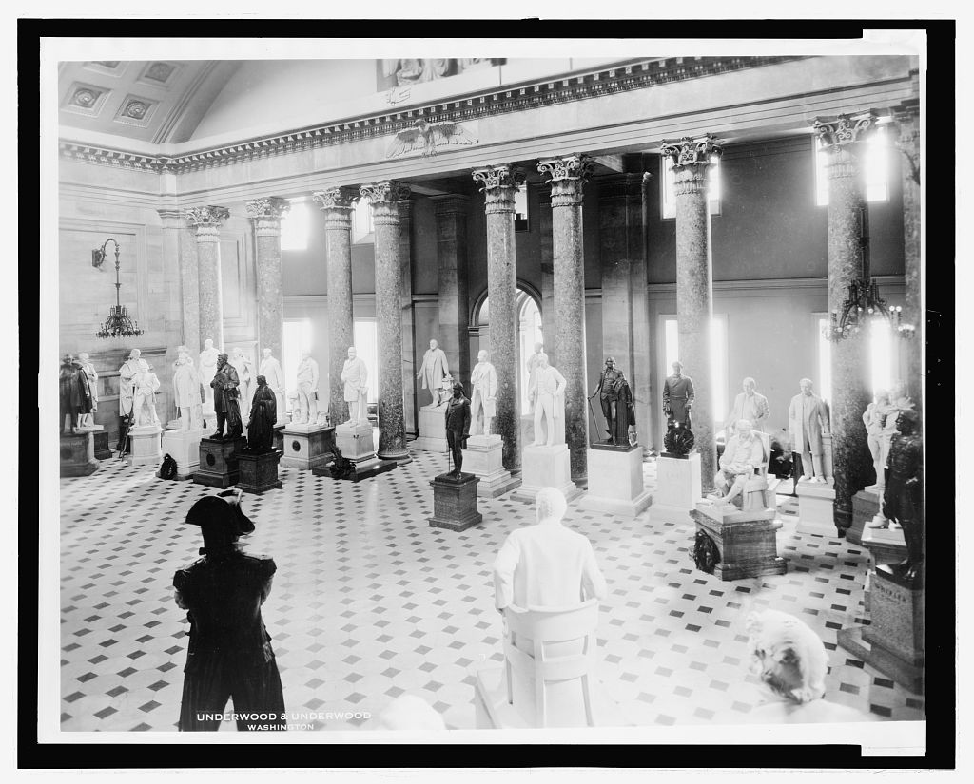
Courtesy of Library of Congress, LOT 12657
National Statuary Hall, cir. 1932
(That’s A LOT of statues!)

Slide 5
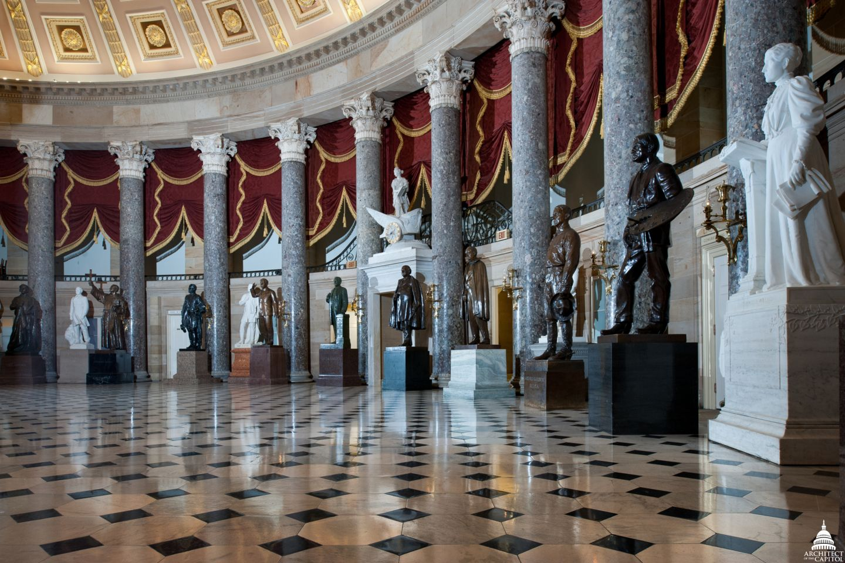
Courtesy of Architect of the Capitol, aoc.gov
National Statuary Hall, cir. 2021

Slide 6
Current Demographics of The National Statuary Hall Collection

Slide 7
There are 100 statues in the
National Statuary Hall Collection.
Two from each state.

Slide 8
Currently, 9 of them are women.

Slide 9
Of the 100 statues, currently, 7 are Native American or
Native Hawaiian, and 2 are of Hispanic descent.
Of these 9 statues, 2 are women.

Slide 10
Several states are currently working towards replacing one or both of their states in the National Statuary Hall Collection

Slide 11
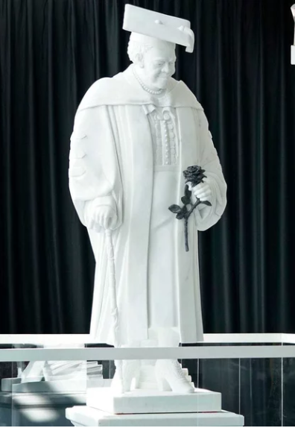
Mary McLeod Bethune Statue
Florida
First African American Statue in National Statuary Hall Collection
Courtesy of www.npr.org/2021/10/14/1045964525/mary-mcleod-bethune-statue-us-capitol-florida-unveiling

Slide 12
Utah’s Contributions to National Statuary Hall Collection

Slide 13
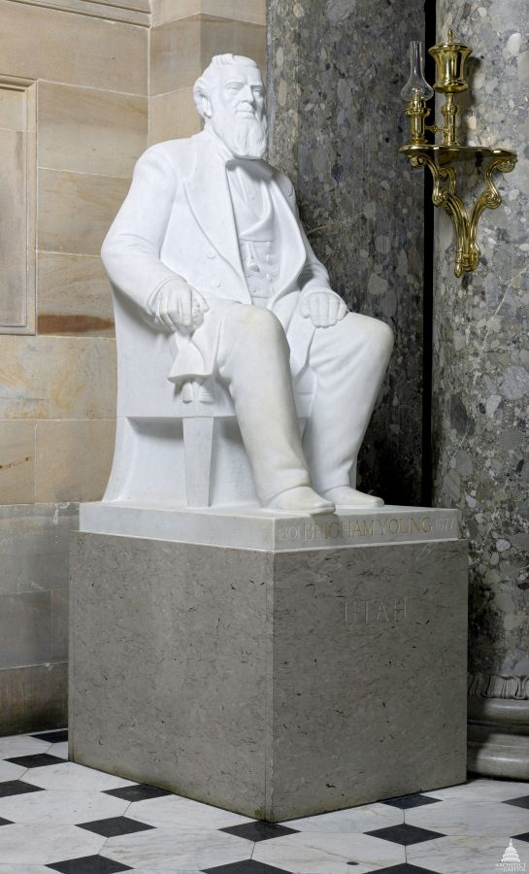
Brigham Young Statue in National Statuary Hall
Courtesy of www.aoc.gov/explore-capitol-campus/art/brigham-young-statue

Slide 14
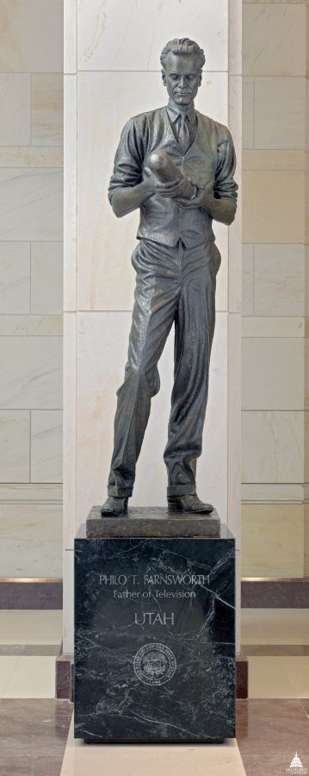
Philo T. Farnsworth Statue in Capitol Visitors Center
Courtesy of www.aoc.gov/explore-capitol-campus/art/philo-t-farnsworth-statue

Slide 15
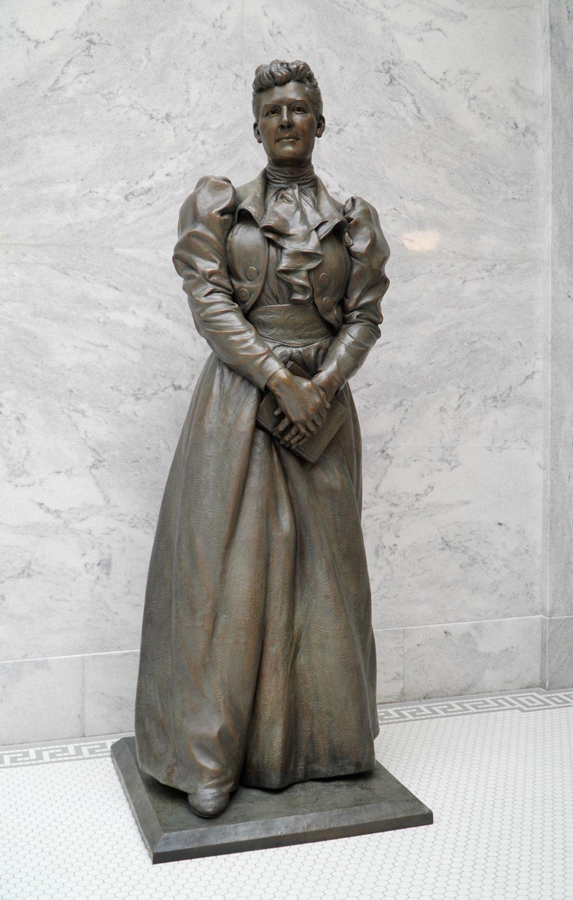
Dr. Martha Hughes Cannon Statue
Expected Installation Date: 2022

